Slide 1

18CSC301T
FORMAL LANGUAGE AND AUTOMATA
REGULAR EXPRESSION TO NFA
By:
ANKIT SINGH (RA2111026010105)
PRATHAM AGARWALLA (RA2111026010073)
ARNAV SHARMA (RA2111026010075)

Slide 2

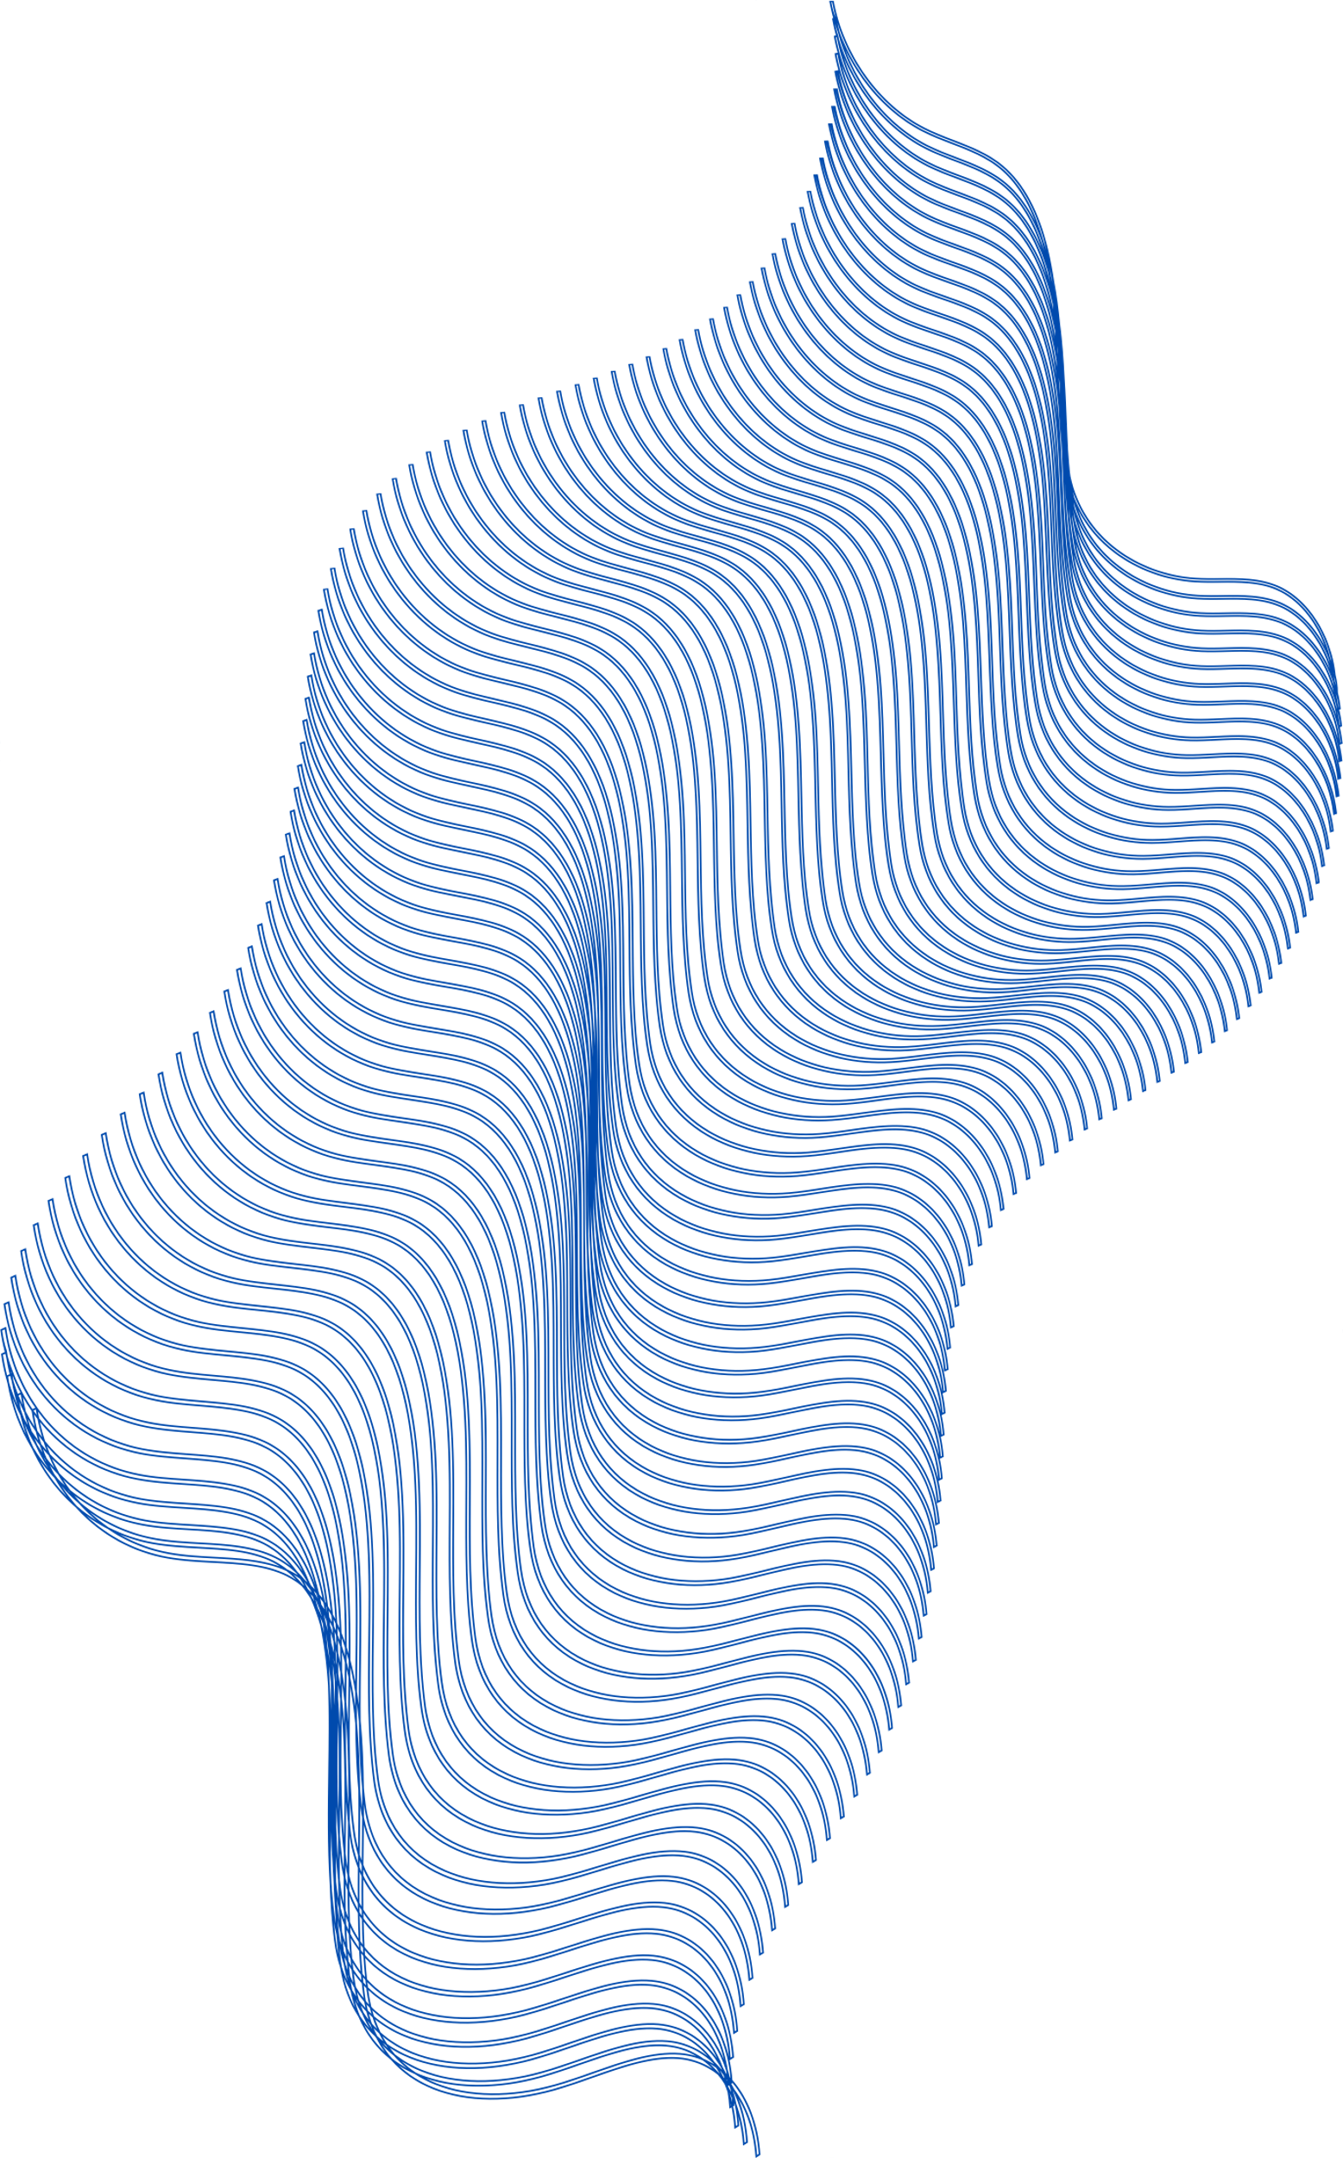
PATTERN MATCHING
Text Processing
Compiler and Parser Design
Data Validation
Automating Text Manipulation
OBJECTIVE
Text Search and Extraction
Data Validation and Input Sanitization
Information Retrieval
Natural Language Processing (NLP)
Text Parsing and Tokenization
APPLICATION

Slide 3
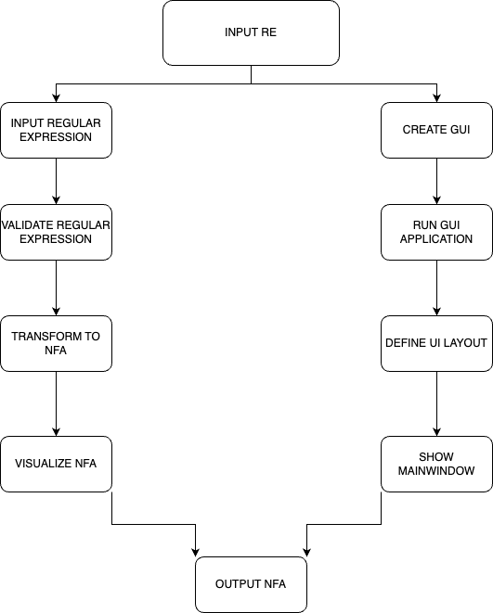

THE
PROCESS

Slide 4

EXPLANATION
Define the Regular Expression: Begin with a given regular expression that you want to convert to an NFA.
Parse the Regular Expression: Parse the regular expression to break it down into its constituent symbols and operators.
Thompson's Construction Algorithm
Final NFA: After applying Thompson's Construction Algorithm to each part of the regular expression, you should have a single NFA that represents the entire regular expression.
Visualize the NFA: To help with understanding and debugging, you can visualize the NFA using a graphical representation, such as Graphviz.

Slide 5
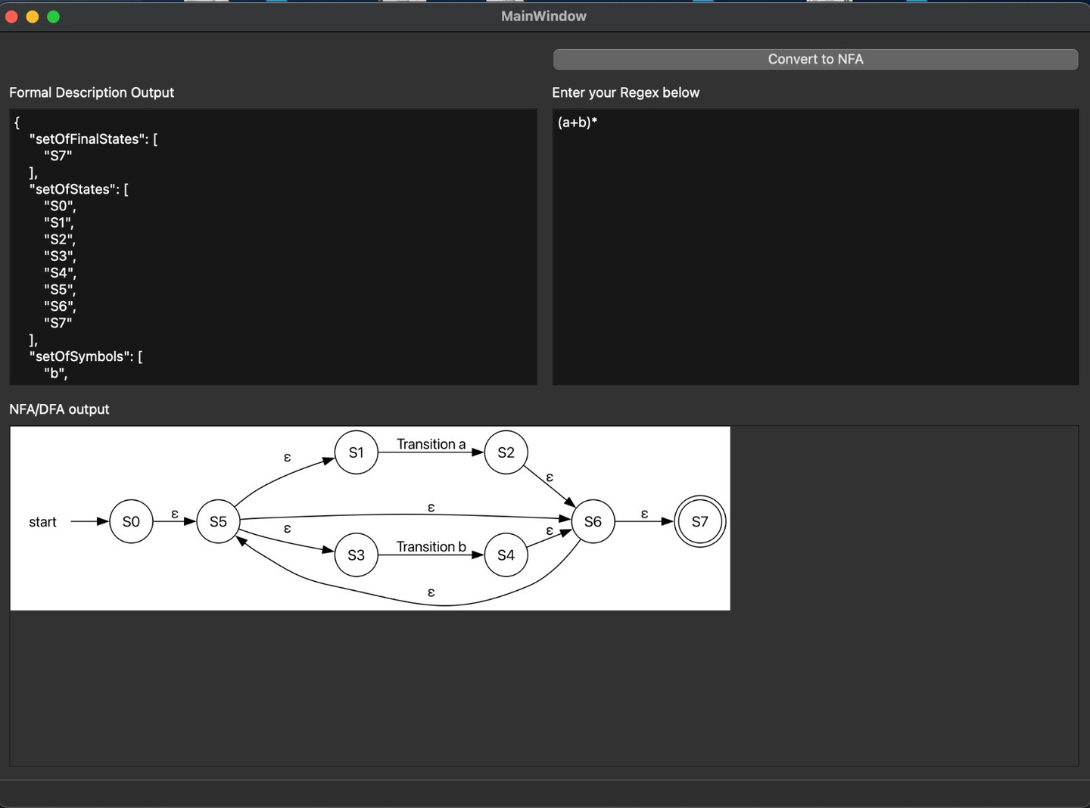
EXAMPLE PROBLEM

Slide 6

OUR TEAM
PRATHAM ANKIT ARNAV
WE HAVE COLLABORATELY DONE THE ENTIRE PROJECT WITH EQUAL CONTRIBUTIONS.

Slide 7
CONCLUSION
IN THIS PROJECT, WE HAVE DEVELOPED A REGULAR EXPRESSION TO NON-DETERMINISTIC FINITE AUTOMATON (NFA) CONVERSION TOOL. THE TOOL PROVIDES A VALUABLE BRIDGE BETWEEN HUMAN-READABLE REGULAR EXPRESSIONS AND MACHINE-UNDERSTANDABLE NFAS.
By leveraging the Thompson's Construction Algorithm and visualizations through Graphviz, our tool offers a user-friendly interface for transforming regular expressions into NFAs. Users can input a wide range of regular expressions and instantly visualize the corresponding NFA, aiding in comprehension and validation of regular expressions.
GITHUB: HTTPS://GITHUB.COM/ARNAV131003/FLA-ASSINGMENT-

